Slide 1



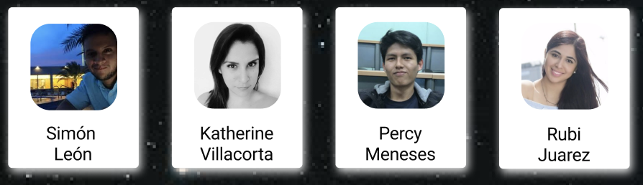
Virtual Rocket
Challenge
How might we create better experiences for people who are perceiving loneliness and depression related to social isolation?
Outdoor environment
Missing loved ones
Lack of concentration
Lack of sleep
Emerging technology
As part of the solution we focus on virtual reality. Virtual reality immerses the person in different scenarios and sensations, allowing the person to develop skills to a maximum level. Virtual reality has no borders or knows beyond what the mind can create in a world without limits.
Notes:
How might we create strategies that can reduce the risk of mental and physical problems during isolation periods?

Slide 2
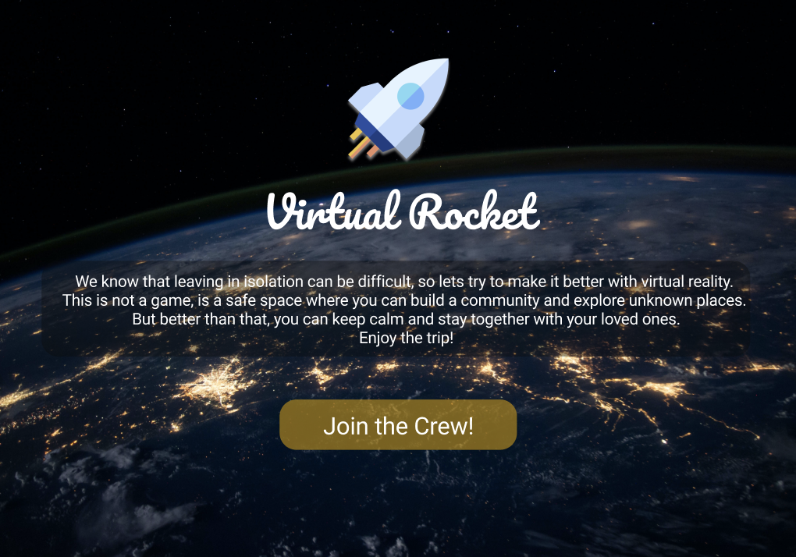

Slide 3
Virtual Rocket 2.0
The future of Virtual Rocket
Virtual Rocket will not only generate an impact on young people. It will be beneficial also for the elder and growing children. We believe that this is not a game, is a space that helps to develop cognitive and behavioral skills.
Emerging technology
Time and space will not be a problem anymore if we integrated artificial intelligence and machine learning to develop new algorithms that allow us to have conversations and share emotions at any moment.
Imagine sharing a dinner with your loved one at the same time from Peru to Japan, attending school at various times of the day because traditional education is not for all children, and even playing basketball with your grandchildren at the age of 90.
Notes:
Time and space will not be a problem anymore if we integrated artificial intelligence and machine learning to develop new algoriths that allow us to have conversations and share emotions at any moment.
Imagine sharing a dinner with your loved one at the same time from Peru to Japan, attending school at various times of the day because traditional education is not for all children, and even playing basketball with your grandchildren at the age of 90.

Slide 4
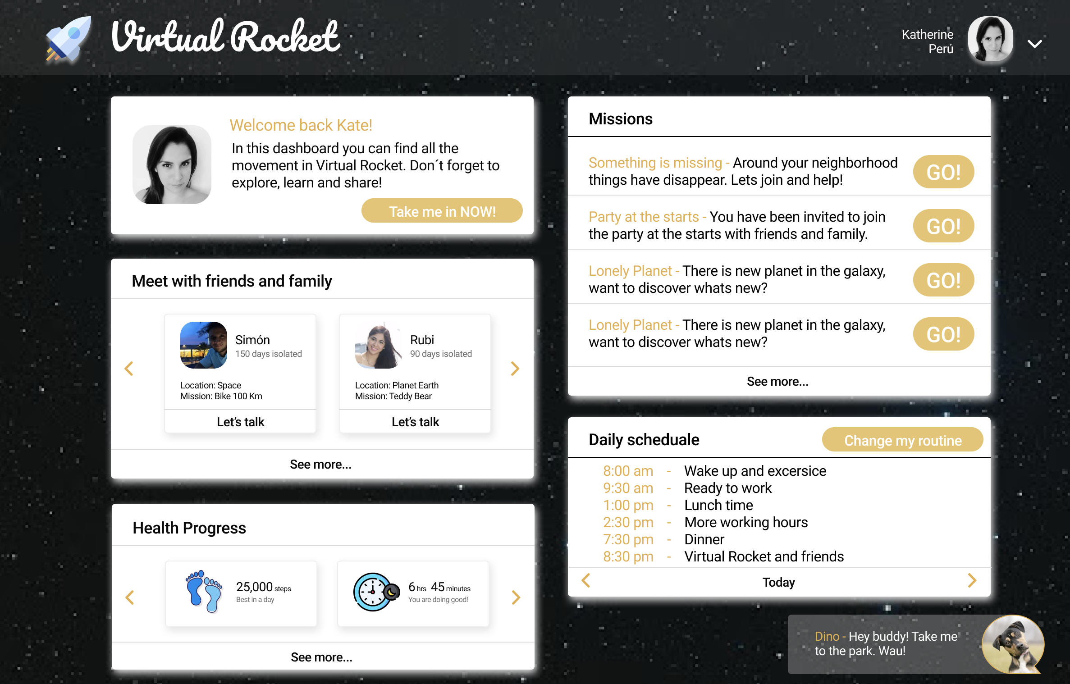
Notes:
Time and space will not be a problem anymore if we integrated artificial intelligence and machine learning to develop new algoriths that allow us to have conversations and share emotions at any moment.
Imagine sharing a dinner with your loved one at the same time from Peru to Japan, attending school at various times of the day because traditional education is not for all children, and even playing basketball with your grandchildren at the age of 90.

Slide 5
References
“Given the extended duration of future missions and the isolated, confined and extreme environments, there is a possibility that (a) adverse cognitive or behavioral conditions will occur affecting crew health and performance; and (b) mental disorders could develop should adverse behavioral conditions be undetected and unmitigated.”
- BMed by Thomas Williams
Anne McClain's Tips for Living in Close Quarters https://www.youtube.com/watch?v=H46sixz9Z4A&feature=emb_title
Hazards of Human Spaceflight | Hazard 2: Isolation & Confinement https://www.youtube.com/watch?v=FPinASEKA_I&feature=youtu.be
Human Research RoadMap documents https://humanresearchroadmap.nasa.gov/risks/risk.aspx?i=99
Development of the mission: https://humanresearchroadmap.nasa.gov/risks/risk.aspx?i=165
Problems with the team: https://humanresearchroadmap.nasa.gov/risks/risk.aspx?i=101
Adverse cognitive or behavioral conditions https://humanresearchroadmap.nasa.gov/risks/risk.aspx?i=99
Muscle performance: https://humanresearchroadmap.nasa.gov/risks/risk.aspx?i=92
NASA International Space Station https://www.nasa.gov/feature/facts-and-figures
Isolation/Confinement https://www.nasa.gov/hrp/bodyinspace
Expeditionary behavior skills https://www.nasa.gov/feature/an-astronaut-s-tips-for-living-in-space-or-anywhere
Characterization of Psychological Risk, Overlap with Physical Health, and Associated Performance in Isolated, Confined, Extreme (ICE) Environments https://taskbook.nasaprs.com/tbp/index.cfm?action=public_query_taskbook_content&TASKID=12495
Psychological Stress Associated with the COVID-19 Crisis https://www.nlm.nih.gov/dr2/Psychological_Stress_Associated_with_the_COVID-19_Crisis_14.pdf
Notes:
Time and space will not be a problem anymore if we integrated artificial intelligence and machine learning to develop new algoriths that allow us to have conversations and share emotions at any moment.
Imagine sharing a dinner with your loved one at the same time from Peru to Japan, attending school at various times of the day because traditional education is not for all children, and even playing basketball with your grandchildren at the age of 90.

Slide 6
Virtual Rocket
Notes:
2) Quienes somos y el reto
3) a quien esta dirigido y problema que soluciona
4) describe la idea y la tecnilogia
5) future

